Slide 1
CSE 203: Data Structures
Lecture 4: Elementary Data Structures- Queue

Slide 2


Queues
FIFO: First in, First Out
Restricted form of list: Insert at one end, remove from the other.
Notation:
Insert: Enqueue
Delete: Dequeue
First element: Front
Last element: Rear

Slide 3
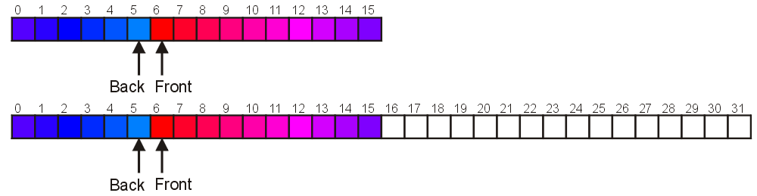
Increasing Capacity
Unfortunately, if we choose to increase the capacity, this becomes slightly more complex
A direct copy does not work:
Notes:
These are not from the book

Slide 4
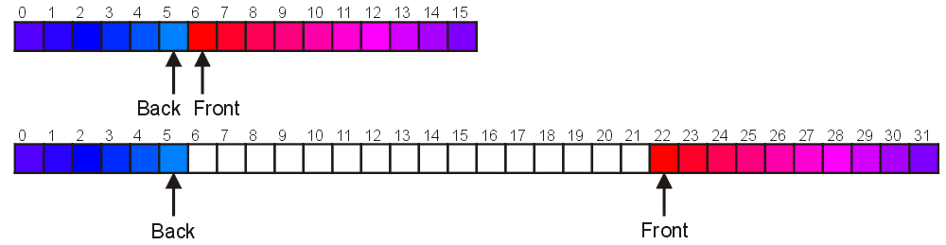
Increasing Capacity
There are two solutions:
Move those beyond the front to the end of the array
The next push would then occur in position 6
Notes:
4

Slide 5
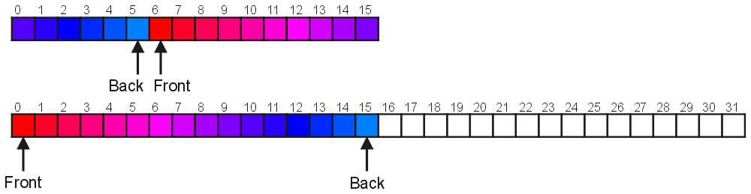
Increasing Capacity
An alternate solution is normalization:
Map the front back at position 0
The next push would then occur in position 16
Notes:
5

Slide 6
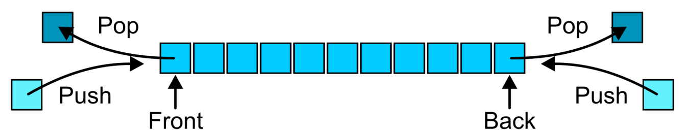
Abstract Deque
An Abstract Deque (Deque ADT) is an abstract data structure that Allows insertions at and removal from both the front and back of the deque

Slide 7
Abstract Deque
The operations will be called
front back
push_front push_back
pop_front pop_back
There are four errors associated with this abstract data type:
It is an undefined operation to access or pop from an empty deque

Slide 8
Applications
Useful as a general-purpose tool:
Can be used as either a queue or a stack

Slide 9
Implementations
The implementations are clear:
We must use either a doubly linked list or a circular array
Notes:
9

Slide 10
Priority Queues
A queue that is ordered according to some priority value
Standard Queue Priority Queue
enqueue dequeue enqueue dequeue
Add at Remove Add Remove
rear end from front according from front
to priority
value
Q
Q
Notes:
10

Slide 11
(MAX/MIN)-Priority Queues
The heap data structure is incredibly useful for implementing priority queues
A data structure for maintaining a set S of elements, each with an associated value or key
Applications:
we can use max-priority queues to schedule jobs on a shared computer.
The max-priority queue keeps track of the jobs to be performed and their relative priorities.
When a job is finished or interrupted, the scheduler selects the highest-priority job from among those pending.
The scheduler can add a new job to the queue at any time

Slide 12
Priority Queue Operations
Insert( S, x ) – Inserts element x into set S, according to its priority
Maximum( S ) – Returns, but does not remove, the element of S with the largest key
Extract-Max( S ) – Removes and returns the element of S with the largest key
Increase-Key( S, x, k ) – Increases the value of element x’s key to the new value k
How could we implement these operations using a heap?

Slide 13
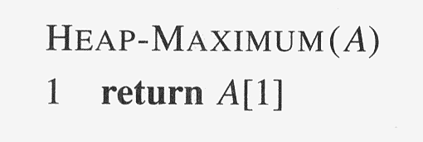
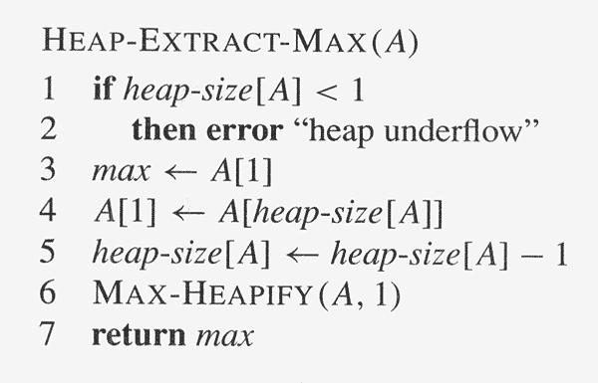
Priority Queue Operations

Slide 14
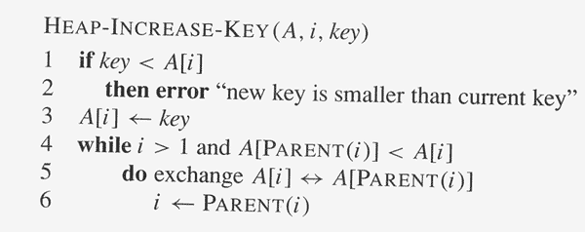
Priority Queue Operations

Slide 15
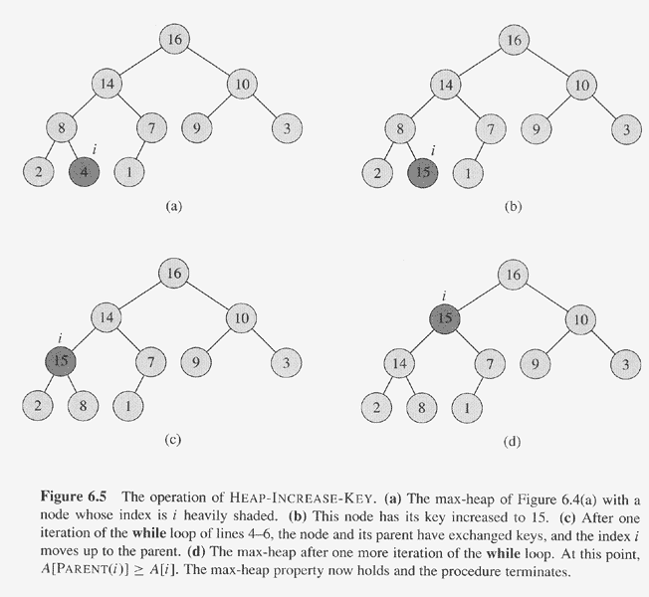
Priority Queue Operations

Slide 16
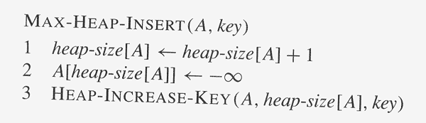
Priority Queue Operations

